Slide 1
Requirements Engineering
Zeeshan Ali Rana

Slide 2
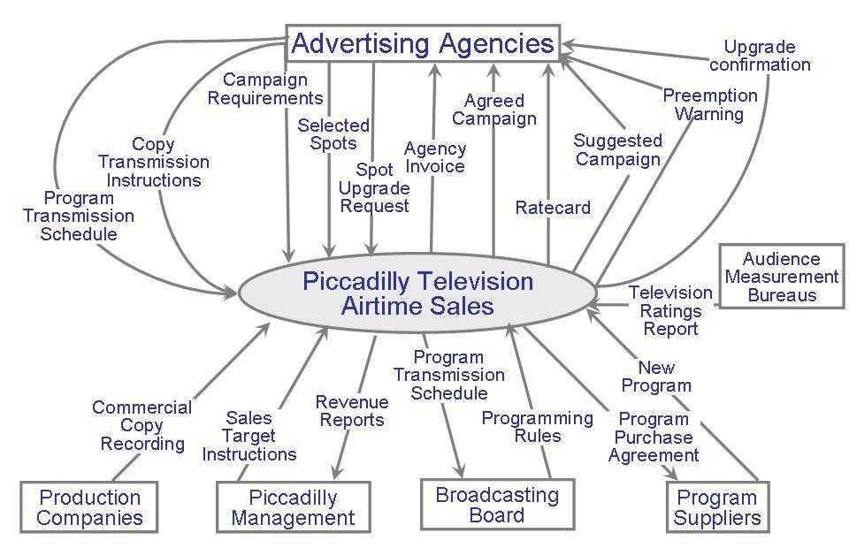
Requirements Engineering
Seven tasks:
Inception
Elicitation
Elaboration
Negotiation
Specification
Validation
Management
(understand problem, people, nature of solution, effectiveness of communication).
Ask questions about objectives, targets, detailed requirements etc.
Identify software function, behavior, information. Develop Requirements Model!!! Analysis???
Resolve conflicts. Prioritize Requirements!!!
Write document containing requirements models, scenarios etc.
Ensure that all requirements have been stated, unambiguously!
Identify, control, track requirements and changes

Slide 3
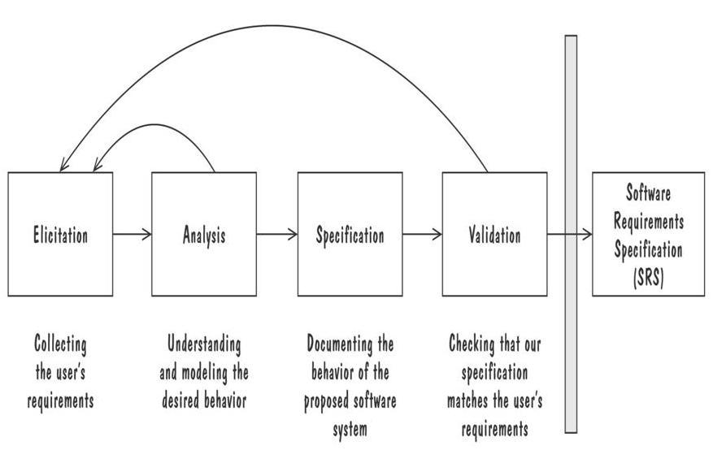
Requirements Engineering
Process for Capturing Requirements

Slide 4
Inception
We need a time series model for the purpose of forecasting demand
Identify: all stakeholders, measurable benefits of successful implementation, possible alternatives
Ask questions stepwise, as early as possible, first meeting/encounter
Possible questions at 1st step (stakeholders, overall goals and benefits):
Who is behind the request for this work?
Who will use this solution?
What will be the economic benefit of a successful solution?
Goods Retailer with physical shops;
Food retailer
E-commerce retailer
Wholesaler (any)

Slide 5
Inception
Possible questions at 2nd step (detailed understanding and customer perception about the solution):
What problems(s) will this solution address?
Can you show me (or describe) the business environment in which the solution will be used?
How do you characterize the ‘good’ output?
Possible questions at 3rd step (effectiveness of communication):
Are you the right person to answer these questions?
Are my questions relevant to the problem that you have?
Can anyone else provide additional information?

Slide 6
A Systems Engineering Approach
SE is a consequence of Systems Engineering
A set/arrangement of elements
Organized to achieve a goal
Processing info
Elements?
Hardware/Software
People
Interactions
Data
Procedures/Rules

Slide 7
A Systems Engineering Approach (Contd.)
Elements of a System:
Objects
i.e. things
Activities
Actions taken
Input / Outputs
Relationships for example:
Which object performs what activities
Which objects are associated with other objects
System Boundary
Who generates input and who receives output
Which objects/activities are part of the system and which are not
Nested systems, related systems, interrelated systems

Slide 8
A Systems Engineering Approach (Contd.)
Model the system as an information transform
Hatley-Pirbhai modeling?
Object | Relevant? | Managed by our system? | Input/ Output? | Related activity | Related object
Activity | Relevant? | Performed by our system? | Receives input? | Responsible for output? | Related Object

Slide 9
Example
We need to develop a water-monitoring system where data are gathered at many points throughout a river valley. At the collection sites, several calculations are done, and the results are communicated to a central location for comprehensive reporting. Such a system may be implemented with a computer at the central site communicating with several dozen smaller computers at the remote locations. Many system activities must be considered, including the way the water data are gathered, the calculations performed at the remote locations, the communication of information to the central site, the storage of the communicated data in a database or shared data file, and the creation reports from the data.

Slide 10
Object | Relevant ? | Managed by our system? | Related Activity/Responsibility | Input/ Output? | Related object
River valley | Y | N
Result | Y | Y |  | Intermediate Output | Report
Remote location | Y | Y | Perform calculations
Central location | Y
Data | Y | Y |  | Input
Collection site | Y | Y
Central site | Y
River valley Info | Y |  |  | Input | Customer
Customer | Y | N |  | - | River Valley Info
Report | Y | Y |  | Output | Result
Activity | Relevant ? | Performed by our system? | Receives input? | Responsible for output? | Related Activity
Perform calculations | Y | Y. Remote location |  | Intermediate
Communicate info | Y | Y |  | Intermediate
Store communicated data | Y | Y |  | Y
Create reports | Y | Y |  | Y

Slide 11
Information Systems Example Piccadilly System
Piccadilly Television: regional British TV franchise
Advertising scheme has many constraints:
Cigarette adverts only after 9 pm
if actor in show, no same actor in advert within 45 minutes
if advert in a class of products, no other advert in same class during same break
rates dependent on amount of time bought
Software to determine, track advertising time

Slide 12
Information Systems Example Piccadilly System (continued)
Piccadilly system’s context diagram

Slide 13
Requirements Elicitation
Ask questions to get requirements
Customers do not always understand what their needs and problems are
It is important to discuss the requirements with everyone who has a stake in the system
Come up with agreement on what the requirements are
If we cannot agree on what the requirements are, then the project is doomed to fail
Involves elements from elaboration, negotiation, specification, problem solving

Slide 14
Elaboration
Analyze, model, specify…
Some Analysis Techniques
Data Flow Diagrams (DFD)
Usecase Diagram
Object Models (ER Diagrams, Abstract class diagrams)
Decision Tables
State Diagrams (Statecharts)
Fence Diagrams
Event Tables
Petri Nets
Event Traces (Message Sequence Charts)
Flow-oriented, Scenario-based, Class-based, Behavioral

Slide 15
Data Flow Diagrams (DFDs)
A data-flow diagram (DFD) models functionality and the flow of data from one function to another
A bubble represents a process (or data transform)
A labelled arrow represents data flow, the label describes the data being transferred
A data store: a formal repository or database of information
Rectangles represent Information source/sink: entities that provide input data or receive the output result
Heritage identifier: to document stepwise refinement

Slide 16
Context Level Diagram
A bubble represents the system
An arrow represents the data flow
Rectangles represent Information Source/Sink: entities that provide input data or receive output results
System
Processed data
Knowledge Source
data
Knowledge Sink

Slide 17
Data Flow Diagrams (DFDs)
Consider a library management system where circulation services allow the Patron to borrow or return a book/item/publication without involvement of Librarian, so the system needs to process these requests. The Librarian controls which items can be borrowed and how can the items be shown to the patrons. The system processes fines also when a borrowed item is returned after the due date. The librarian is able to reserve an item if required and a recall notice is sent to the patron as a consequence. The record of reserved items is kept so that the librarian can view which items have been reserved already.
A verb in requirements narrative is potentially a process, a noun is either data, or external entity, or data store

Slide 18
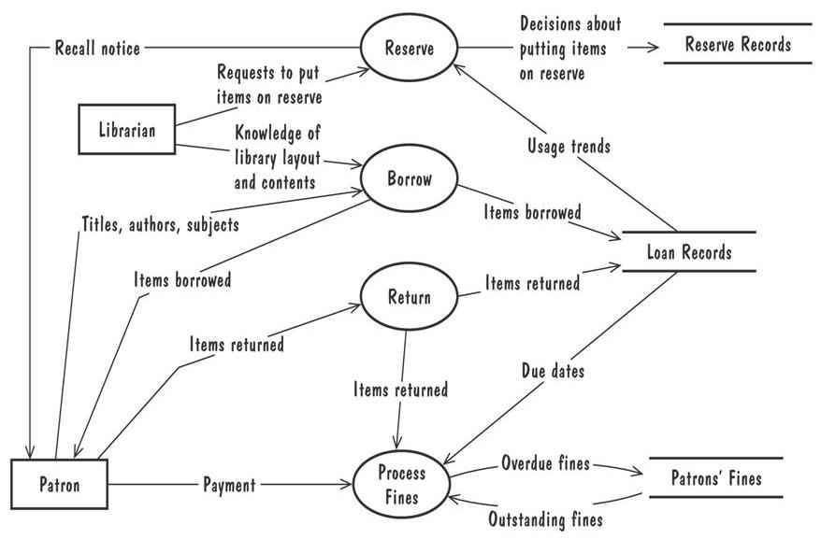
Data Flow Diagrams (Contd.)
A Level 1 data-flow diagram for the library problem
Process Reserve Requests
1
Process Borrow Requests
2
Process Returns
3
4
A verb in requirements narrative is potentially a process, a noun is either data, or external entity, or data store

